Slide 1
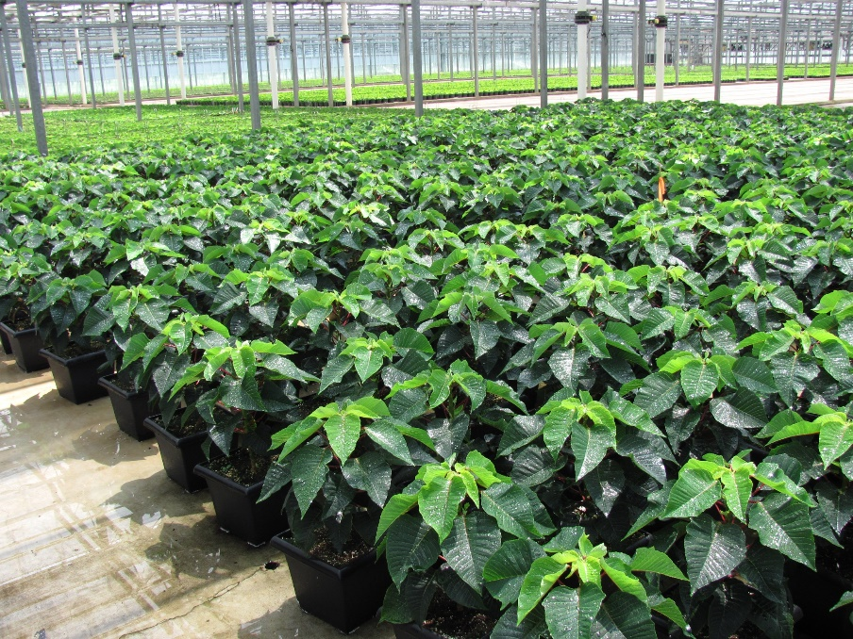
The IR-4 Project (or Inter-Regional project number 4) was created in 1963 to facilitate
What is IR-4?
registration of sustainable pest management technology for specialty crops and minor uses
Photo by Cristi Palmer

Slide 2
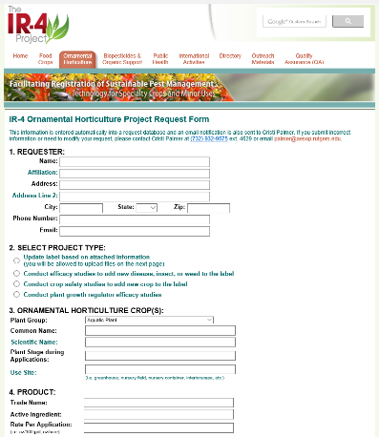
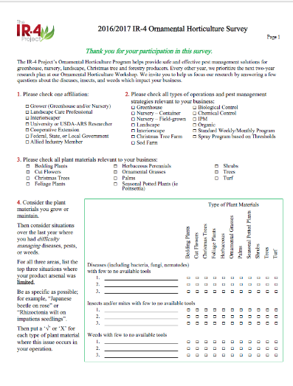
How are research projects selected?
Stakeholder Input
balanced with
Researcher & Registrant Input
Project Criteria
Availability & effectiveness of current options
Damage potential of target
Performance and crop safety of proposed products
Compatibility with IPM, resistance management programs
Economics
Geographic distribution
Registrant interest in labeling product(s)
Other
Online Project Request Form
Paper or Online Biennial Survey

Slide 3
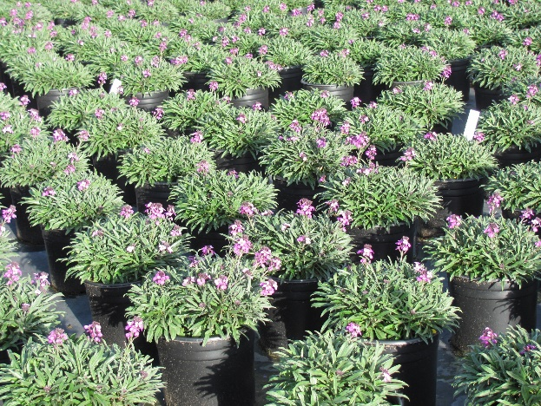
What does this mean for Environmental Horticulture?
Since the Orn Hort Program was added in 1977,
- more than 790 products & numbered active ingredients have been screened for performance
- about 33,000 trials have been conducted
- and more than 38,000 crop uses are now available for growers and landscape managers
Photo by Cristi Palmer
Program statistics as of Jan 2017

